Slide 1
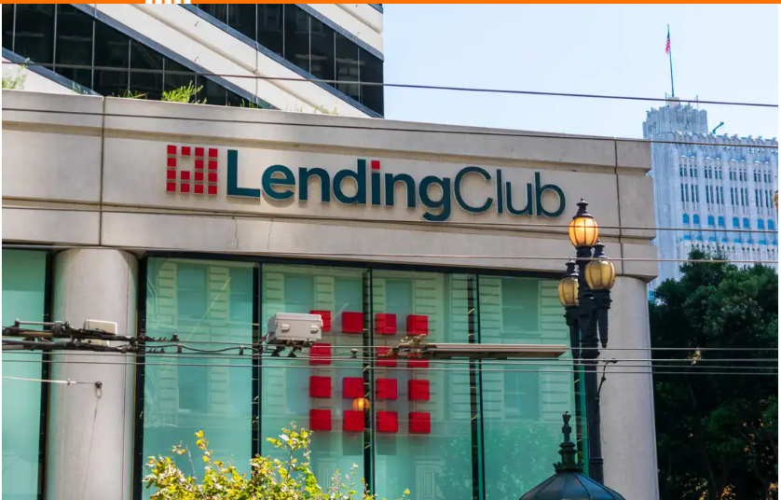
CASE STUDY
By: Shagufta Naaz Shaikh & Syed Zuhair Abbas
Batch :ML C56

Slide 2


PROBLEM STATEMENT:
A consumer finance company is lending various types of loan to the urban customer.
When a company receives a loan application it has to make a decision for loan approval based on applicants profile.
Two types of risks associated with the Bank’s Decision
1. If the applicant is likely to repay the loan, then not approving the loan results in a loss of business to the company.
2. If the applicant is not likely to repay the loan, i.e. he/she is likely to default, then approving the loan may lead to a financial loss for the company.

Slide 3
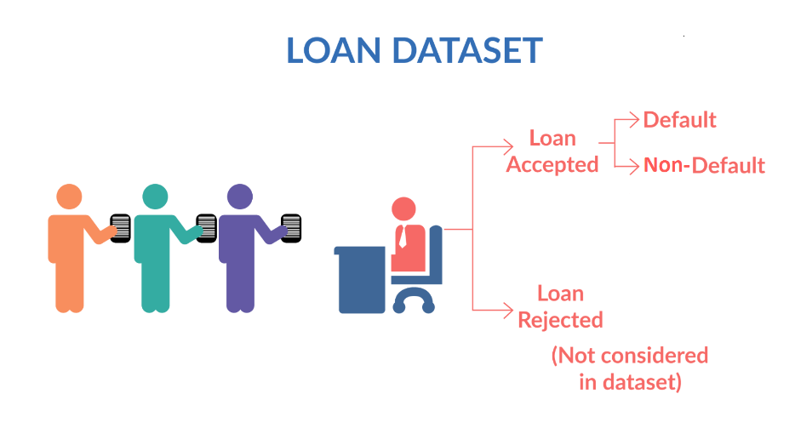
When a person applies for a loan, there are two types of decisions that could be taken by the company:
Loan accepted: If the company approves the loan, there are 3 possible scenarios described below:
Fully paid: Applicant has fully paid the loan (the principal and the interest rate)
Current: Applicant is in the process of paying the instalments, i.e. the tenure of the loan is not yet completed. These candidates are not labelled as 'defaulted'.
Charged-off: Applicant has not paid the instalments in due time for a long period of time, i.e. he/she has defaulted on the loan
Loan rejected: The company had rejected the loan.Since the loan was rejected, there is no transactional history of those applicants with the company and so this data is not available with the company.

Slide 4
APPROACH:
EDA is used to understand how consumer attribute and loan attributes influence tendency of default.
Data Reading.
Data Cleaning is then most important task, bad quality data can be detrimental to processes and analysis.
Data Filtering limiting rows and columns one of the most frequent data manipulation operation.
Data Analysis forms the foundational bedrock upon which data exploration and comprehension are build.
1. Univariate Analysis:
Ordered and Un ordered
Quantitative Variables
2. Bivariate Analysis compare more than two variables has more than one dependent variable.
Categorical and continuous variables
Segmented data
LOAN_AMNT_RANGE,
EMP_LEN_RANGE
INTEREST_RATE_RANGE
Correlation Metrics
3. Derived Metrics
Data set taken in Data frame is first analysis on ONLY CHARGE OFF(rslt_df) then Entire DATA FRAME (df2)

Slide 5
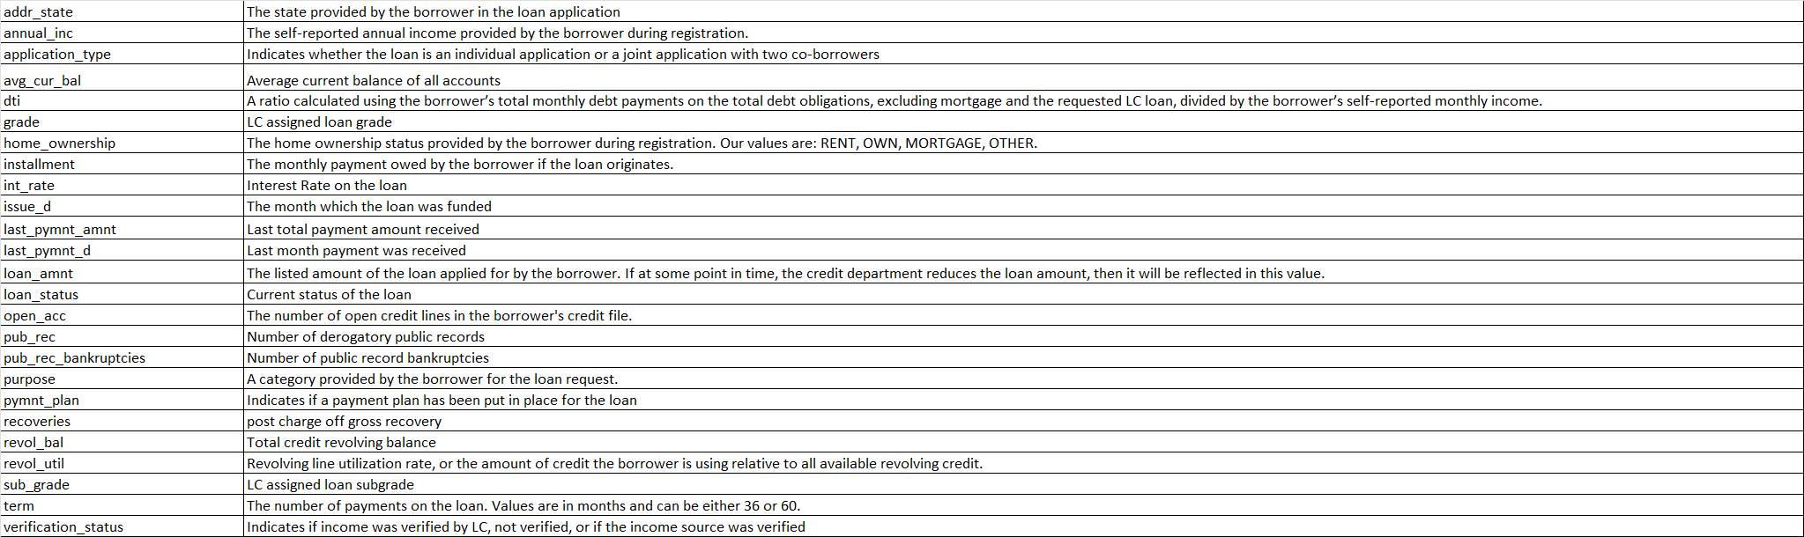
ANALYSIS OF VARIABLES:
Categorical variable are qualitative variables that represent categories or groups.
eg. home_owner, sub_grade, grade, loan_status, verification_status,year, purpose
Ordered Variable: Grade, sub grade , term
Un ordered : Loan status, verification status , purpose ,home_owner ship,addr_state
Continuous variable are quantitative variables that can take an infinite number of values within a given range.
Quantitative : Apart from above rest like dti, installment, loan_amnt etc . Are continuous vars
3. Segmented Data
LOAN_AMNT_RANGE,
EMP_LEN_RANGE
INTEREST_RATE_RANGE
4. Derived Data : For the purpose of this case study following data was derived
CHARGE_OFF_PROPORTION
YEAR
EMPLOYEE _EXPERIENCE

Slide 6
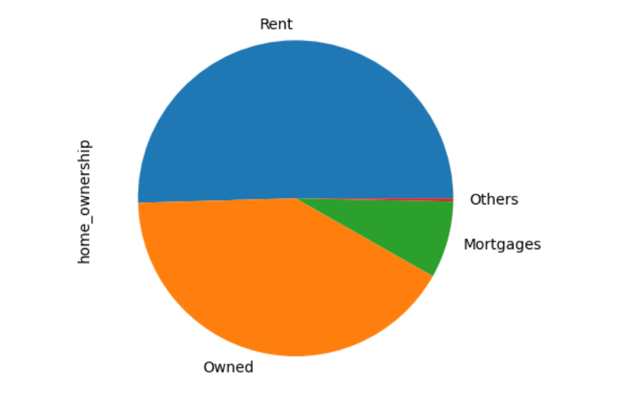
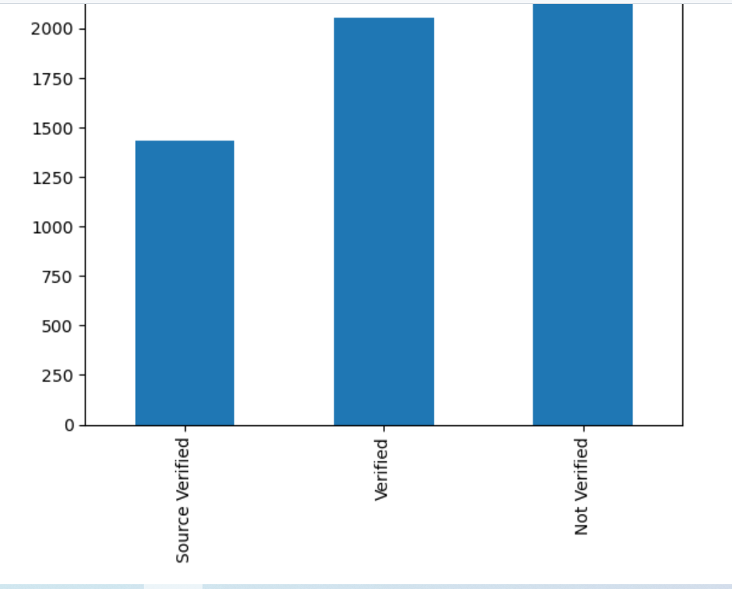
VISUALISING AND SUMMARISING
Data Distribution by Ownership
Data distribution by Verification status
Inference : Customers who are on RENT are more likely to default and hence HIGH risk customer.
Inference : Customers are NOT having proper Verification are more likely to default and hence High risk customers.
Data set is only for charge Off

Slide 7
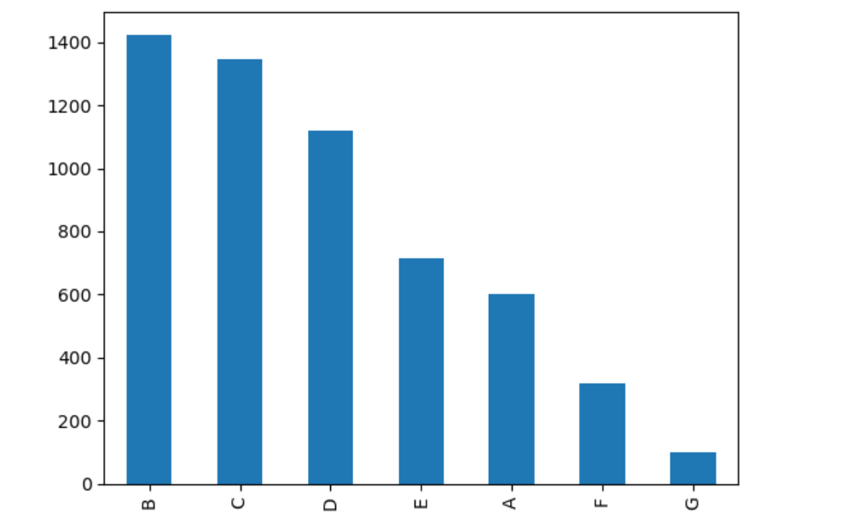
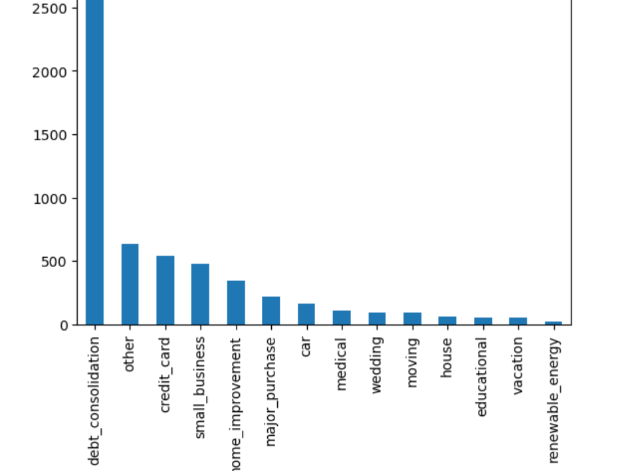
Data distribution by Grade
Inference : Not much visibility by this data except that B and C grades are more likely to default within defaulters.
Inference : Debt consolidation purpose is the main category for charge off.
Data set is only for charge Off

Slide 8
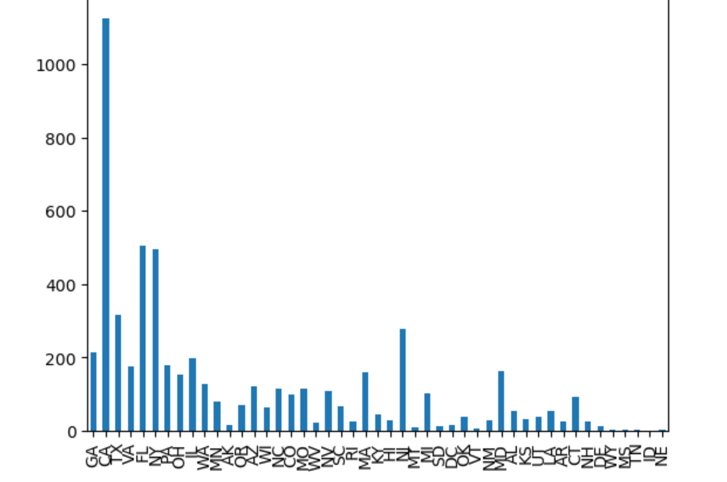
Data distribution by Address State
Inference : Maximum charge off are from California that means better checks in CA state and FL or NY.
Data set is only for charge Off

Slide 9
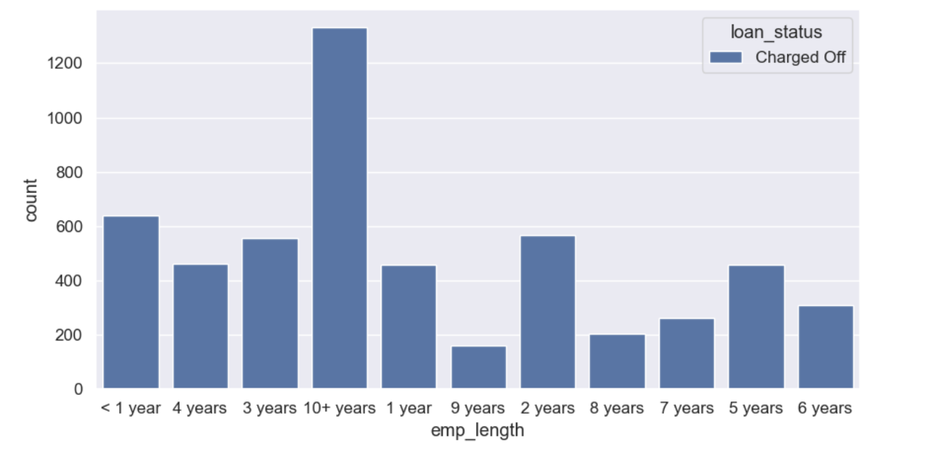
Inference : Maximum charge off are from either less experience or more than 10 years.
Data set is only for charge Off

Slide 10
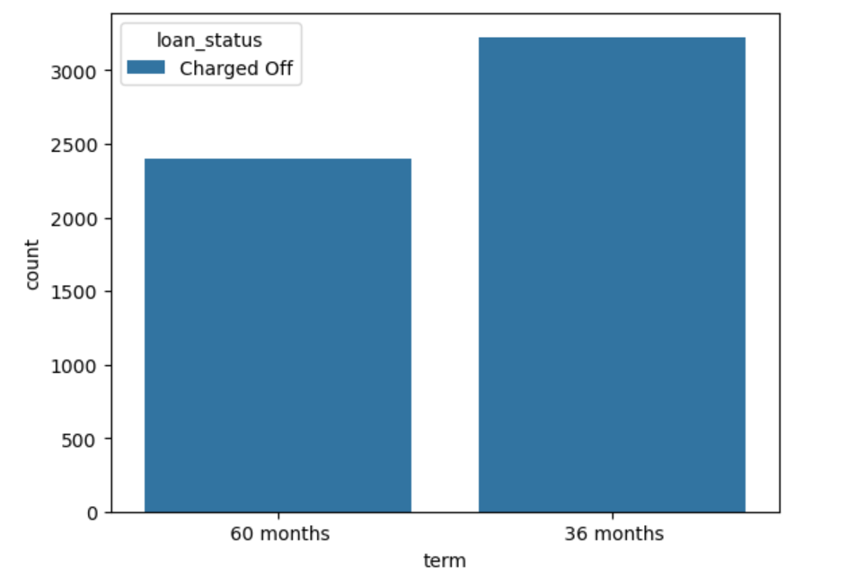
Inference: This shows that candidates with less term are more defaulters.
Data set is only for charge Off

Slide 11
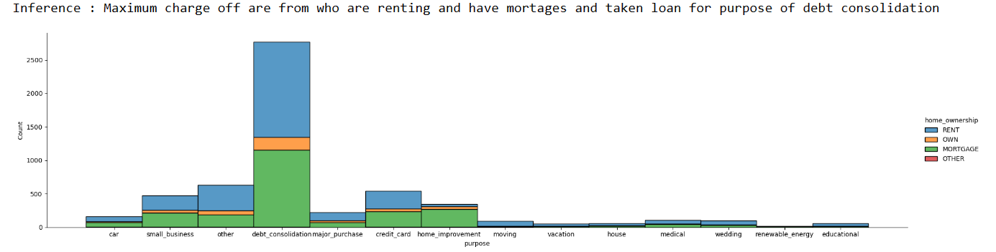
Data set is only for charge Off

Slide 12
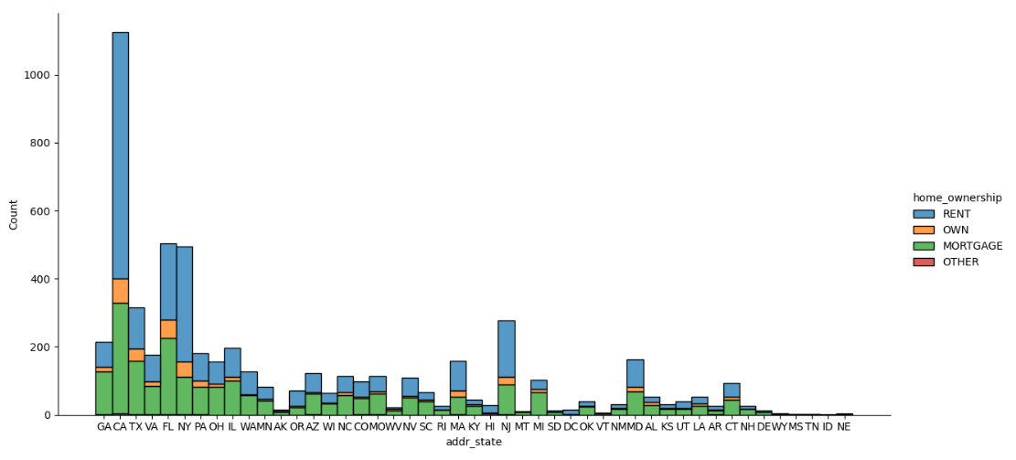
Inference: Rented owners and with non verified status are likely to charge off and is prominent in CA.
Data set is complete now including all Rows

Slide 13
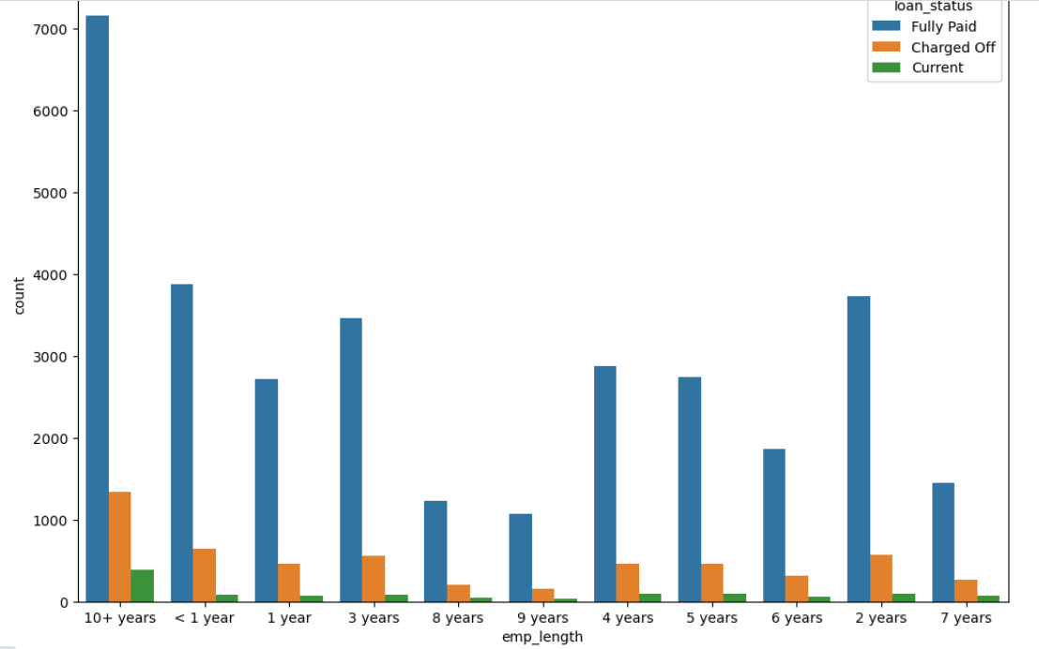
Data distribution by experience of employee.
Inference: Ability to pay loan is directly proportional to number of year of service as we can see here more the experience- more he is likely to repay the loan.
Data set is complete now including all Rows

Slide 14
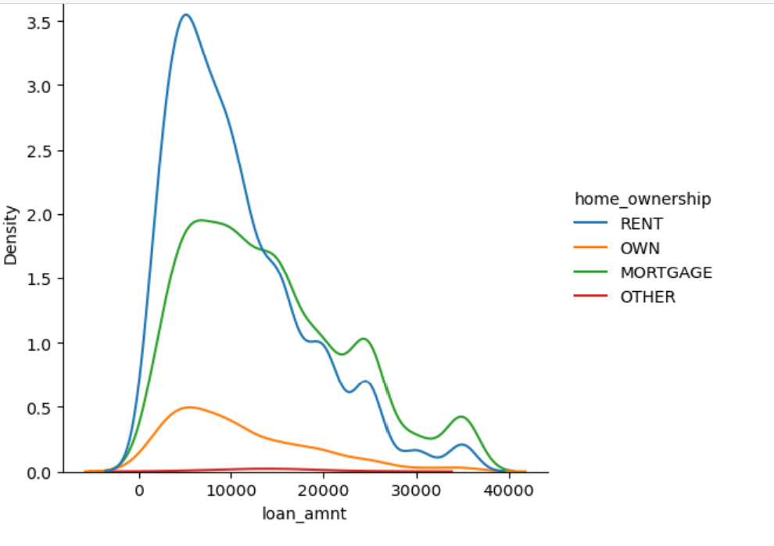
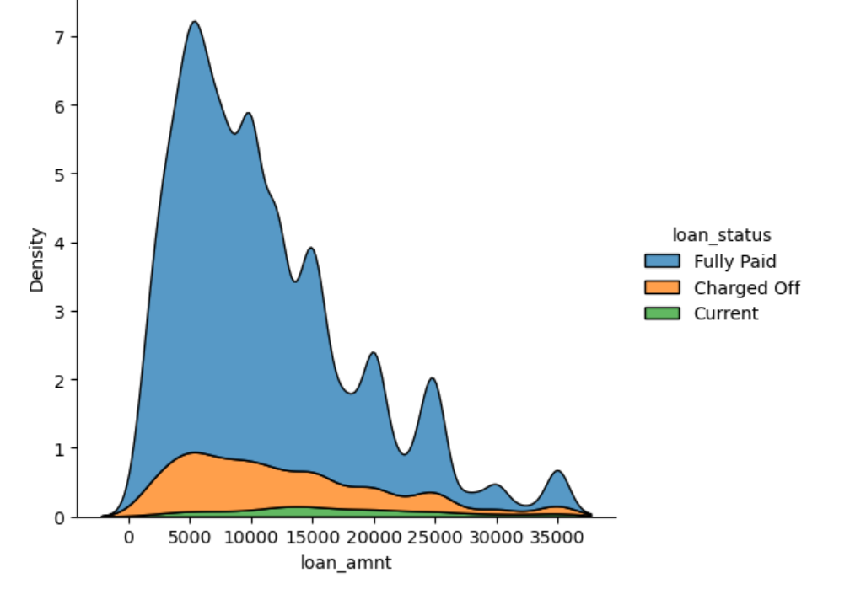
Inference : Loan amount less than 10000 with rent or mortgages have highest defaulters this needs further analysis.
Inference : Loan amount less than 10000 have higher probability for charge off.
Data set is complete now including all Rows

Slide 15
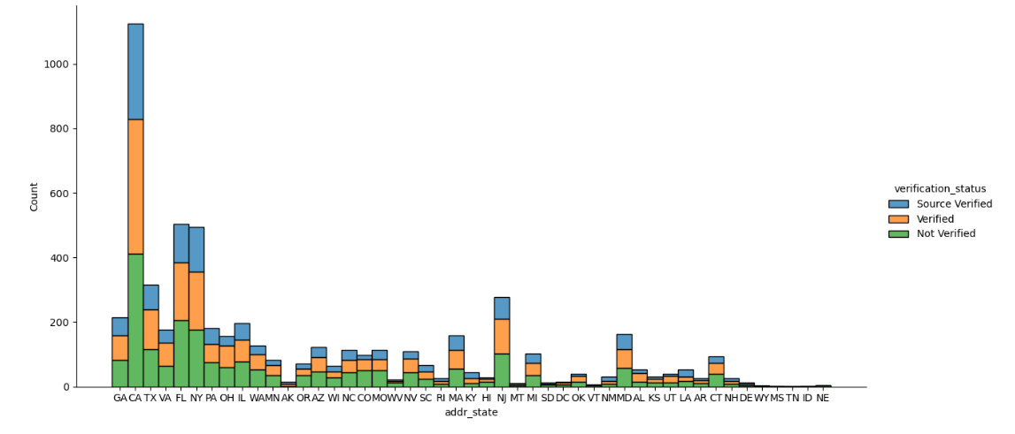
Inference: Rented owners and with non verified status are likely to charge off .

Slide 16
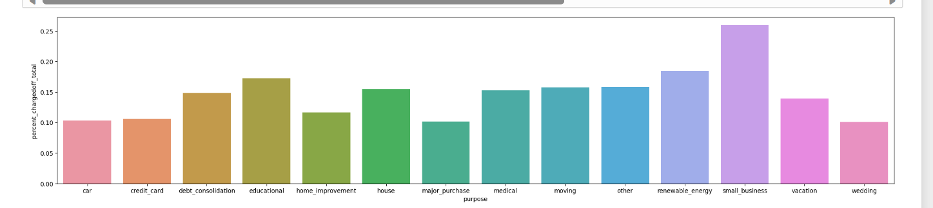
Inference: Data is grouped by purpose and derived value charge off percent , we see that small business and renewable energy are more likely to charge off .

Slide 17
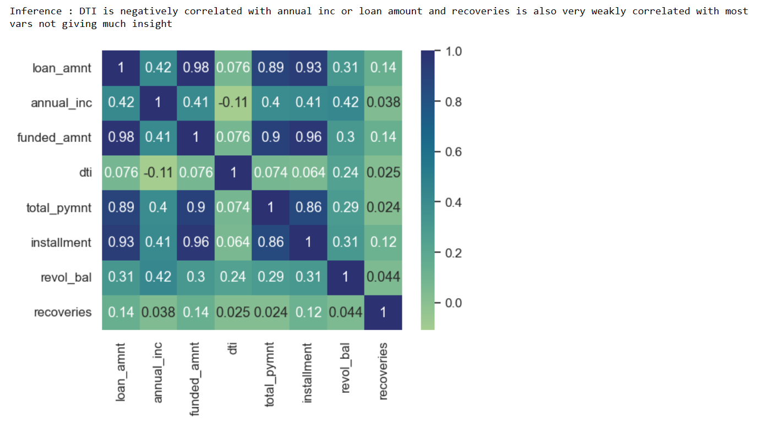

Slide 18
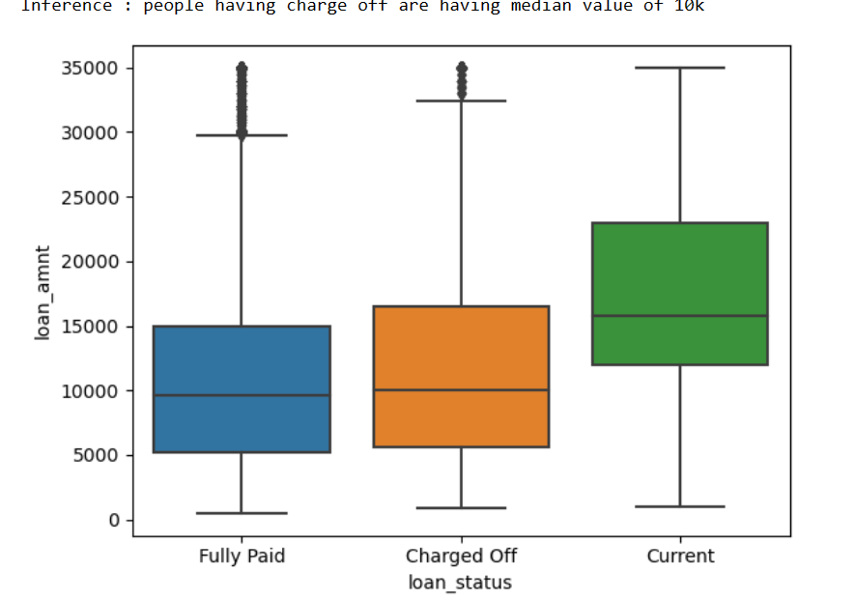
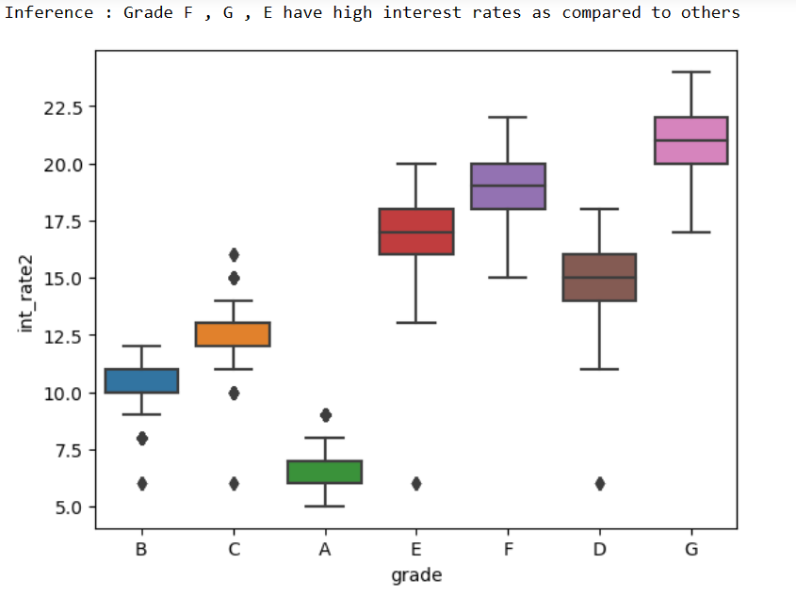
Inference

Slide 19
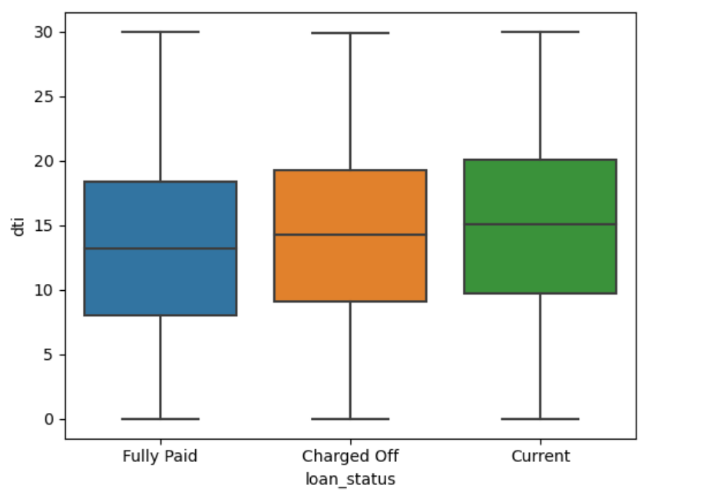
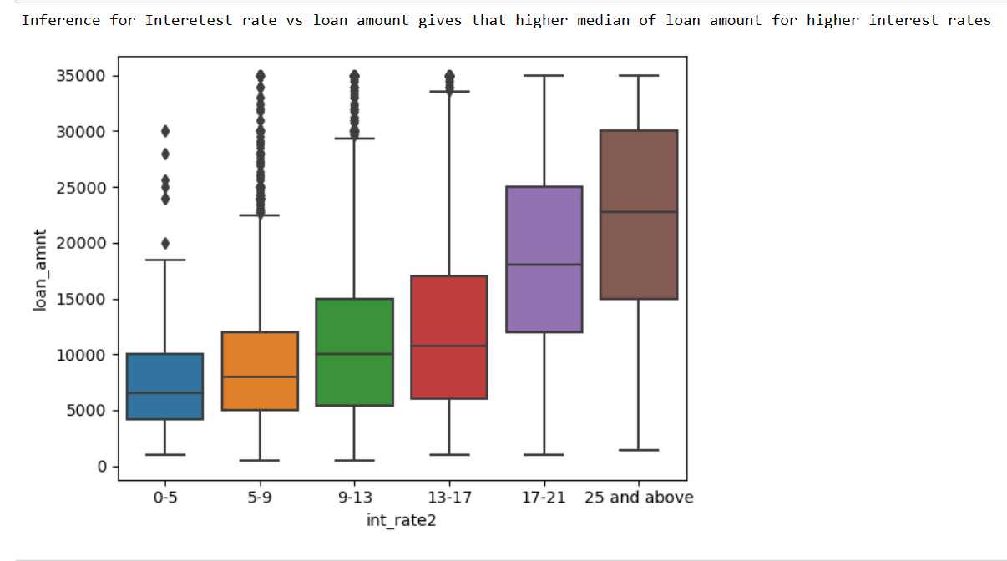
Inference: DTI v/s loan status gives that charge off have higher median than fully paid.

Slide 20
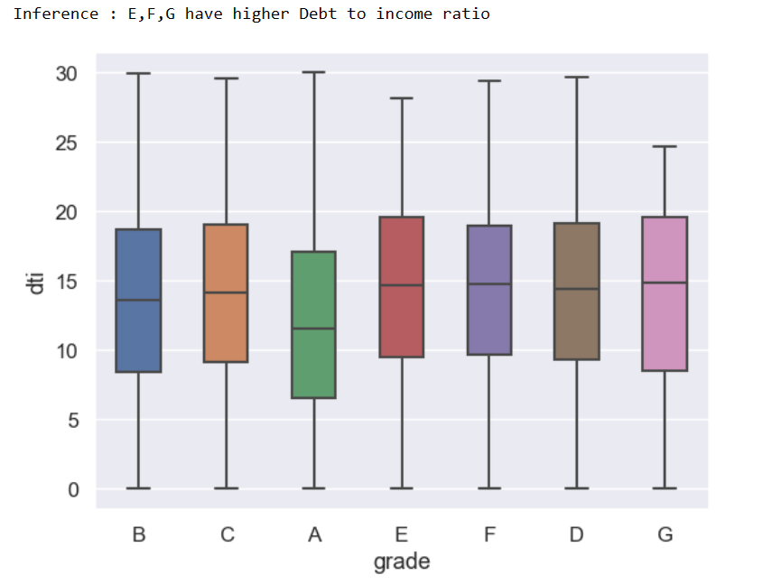

Slide 21
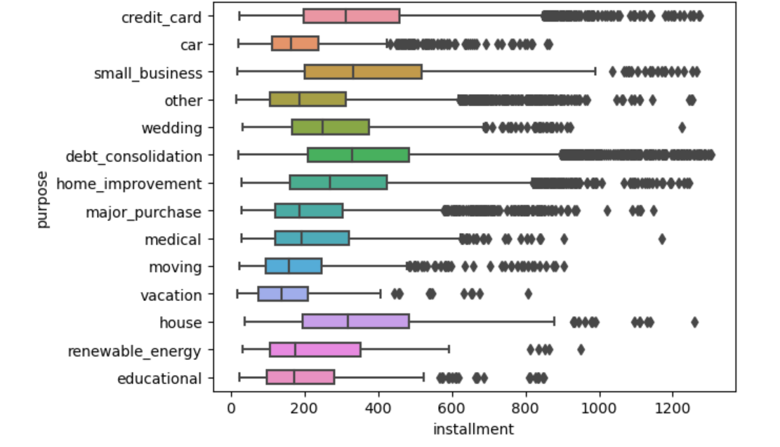
Inference: Installments for credit card , debt consolidation , small business and house are more with regards to others.

Slide 22
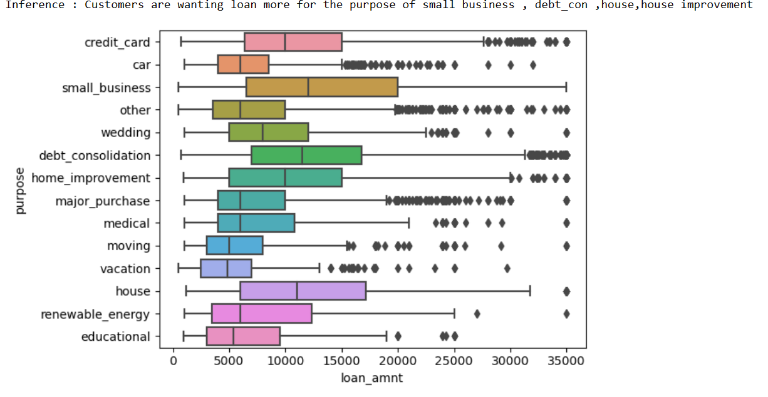

Slide 23
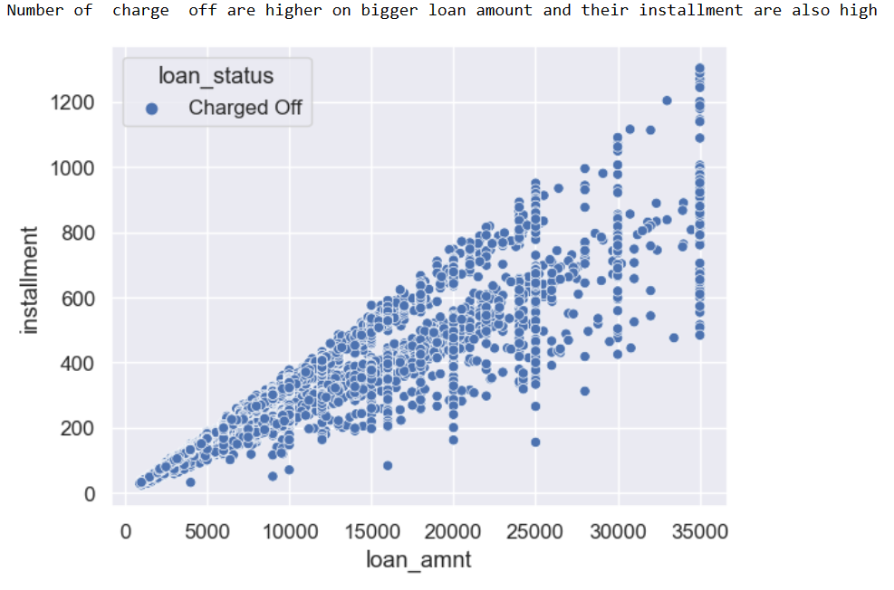
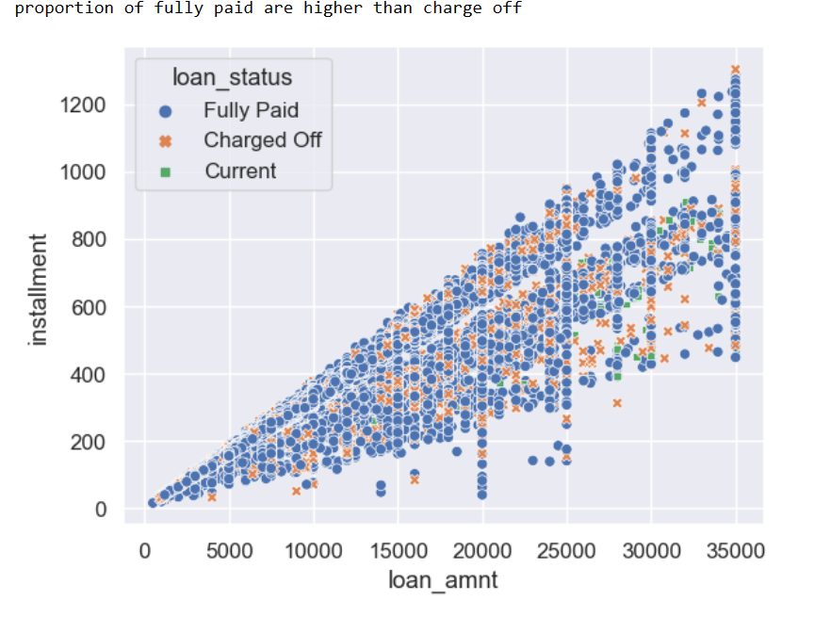

Slide 24
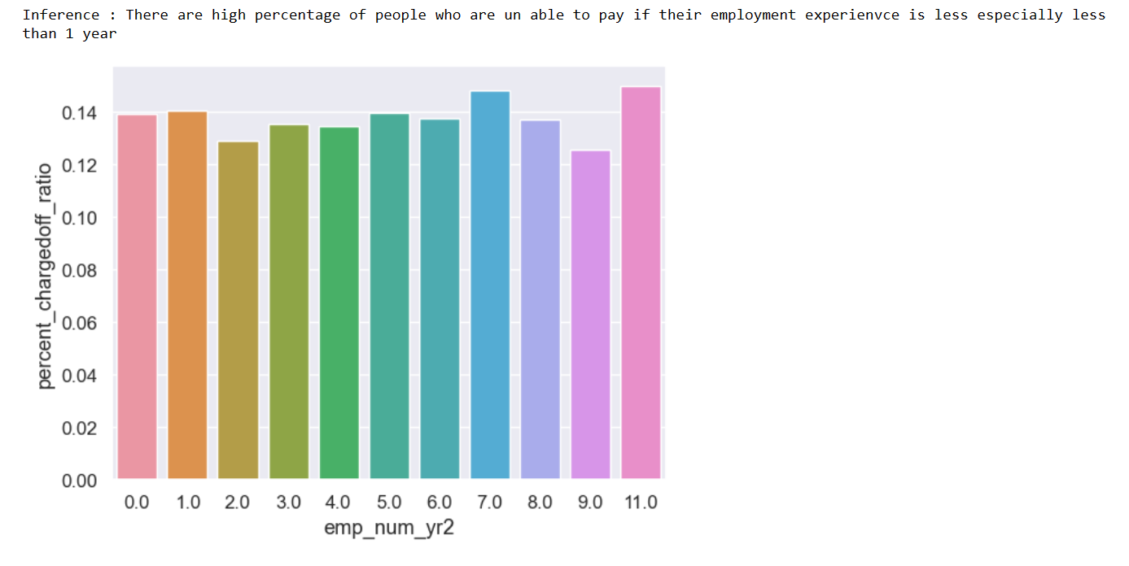

Slide 25
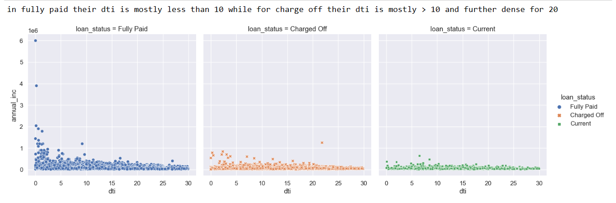

Slide 26
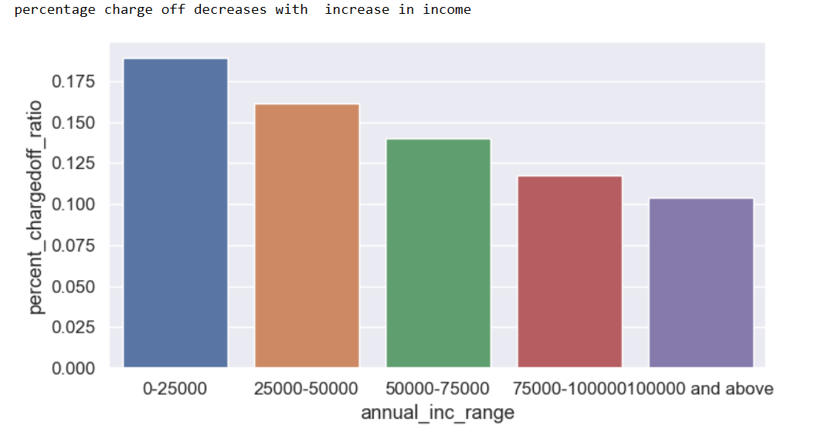

Slide 27
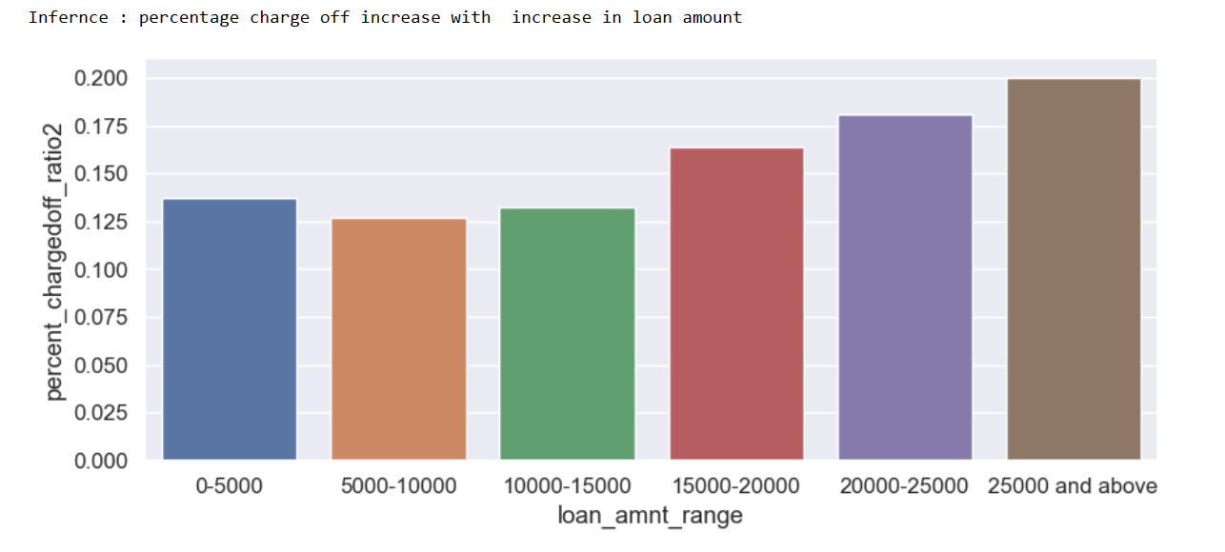

Slide 28
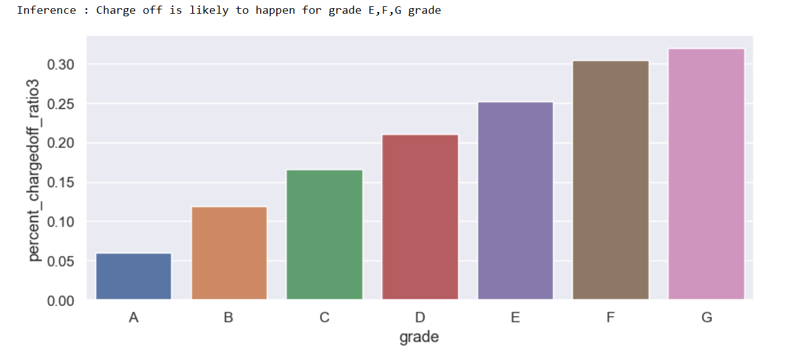

Slide 29
Summary of EDA
Candidates with high loan amount are more likely to charge off
Grades E,F,G have higher tendency to charge off
Grade F , G , E have high interest rates as compared to others
Grade E,F,G have higher Debt to income ratio
Candidates with high income are less likely to default
Candidates with high interest rates are likely to default
Debt to Income ratio (DTI) Is better for Fully paid candidates
Candidates having less Employee Length(exp) are more likely to not pay the loan
Charge Off are higher for high installments
Customers who are on RENT or who are non verified are more likely to default and hence High risk customers
Candidates are wanting loan more Purpose of home, small business and they take it for less term
Installments for credit card , debt consolidation , small_business and house are more with regards to others
Candidates who have taken loan for purpose of small business are more likely to default along with Debt consolidation
Most percentage of defaulters is in range of less than 10k with rent or mortgages
Maximum charge off are from California that means better checks in CA state and FL or NY
DTI is negatively correlated with annual inc or loan amount and recoveries is also very weakly correlated with most vars not giving much insight
Interest rate vs loan amount gives that higher median of loan amount for higher interest rates

Slide 30



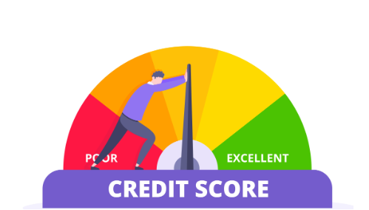

STRATEGIES TO OVERCOME LOAN DEFAULTERS:
Strict screening by implementing rigorous screening processes to assess the creditworthiness of borrowers.
Credit scoring models should be used to evaluate applicants credit histories and assess risk level.
Communication maintain open lines of communication with borrowers to address financial difficulties.
Risk Mitigation diversify the loan portfolio to reduce concentration risk. Periodically review and update risk management policies and practices.
Clear Terms ensure that loan terms are clear and easy to understand for borrowers.
Data Analysis continuously analyze loan performance data to identify trends and patterns related to default and implement proactive measures.
Technology Integration leverage technology for automation of routine tasks, streamlined processes and better data management.

